Slide 1


OpenAI Functions & LLM: Empowering HR Onboarding
Welcome to the world of OpenAI functions and how they can be leveraged for HR Onboarding. Get ready to dive into the exciting possibilities.
by Amit Mishra, Amit Basnak

Slide 2
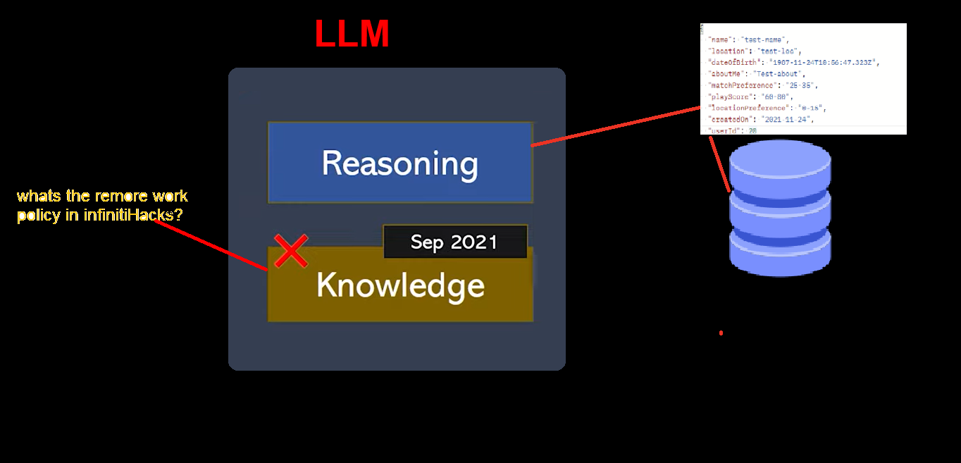

Solution Overview
1
LLM
2
OpenAI Function Calling🔬
Large Language Models (LLMs), such as OpenAI GPT-4, are state-of-the-art deep learning models based on transformer architecture. These models are pre-trained on vast amounts of internet-scale data to predict the next token in a sequence. LLMs are already revolutionizing various business solutions due to their ability to generate human-like text at scale.
Functions to gpt-3.5-turbo-0613, and have the model intelligently choose to output a JSON object containing arguments to call those functions. This is a new way to more reliably connect GPT's capabilities with external tools and APIs. These models have been fine-tuned to both detect when a function needs to be called (depending on the user’s input) and to respond with JSON that adheres to the function signature
3
NLP and GPT-3 🗣
GPT-3 used to generate chatbot responses from open AI models.

Slide 3
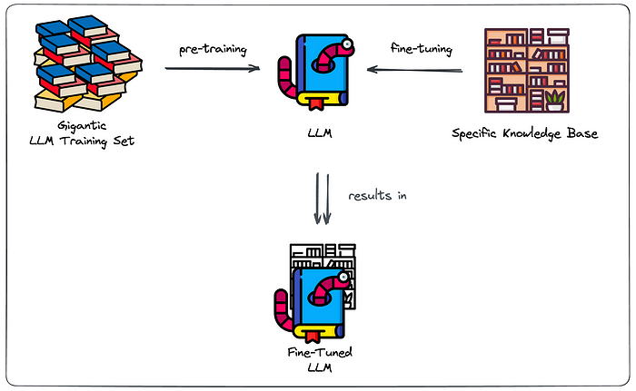
LLMs present two major
challenges due to their pre-trained nature. Firstly, they often struggle to
provide coherent and accurate responses on topics they have not been trained on,
especially content that is not publicly available. Secondly, LLMs are prone to producing unreliable responses, often referred to as “hallucinations,” where they generate confidently incorrect information.
presenting Tenzie the Bookworm with all the books in your very specific knowledge base
and letting him gobble up all that tasty extra information.
This way, the LLM bookworm Billy doesn’t just know all of that general information,
he also “knows” a lot about the contents of your specific knowledge base.
Why fine-tuning won’t always cut it
Crucial Problems
1. No source clarity. It’s difficult to prevent hallucination and your LLM has no clear distinction between “general” and “specific” knowledge.
3. Hosting an LLM is costly. Once you have a fine-tuned LLM, you have to keep it spinning. A large language model is well… large. Costs to keep it up and running will rack up. Do the benefits outweigh those costs?
2. No access restriction. Imagine a case where some users should be able to query the information of strategic documents while others shouldn’t. How would you tackle this? Your fine-tuned Billy just knows everything, he can’t choose to leave out knowledge at inference time.
Fine-tuning repetitions. Model retraining is required when you want the model to reflect changes to the knowledge base.

Slide 4
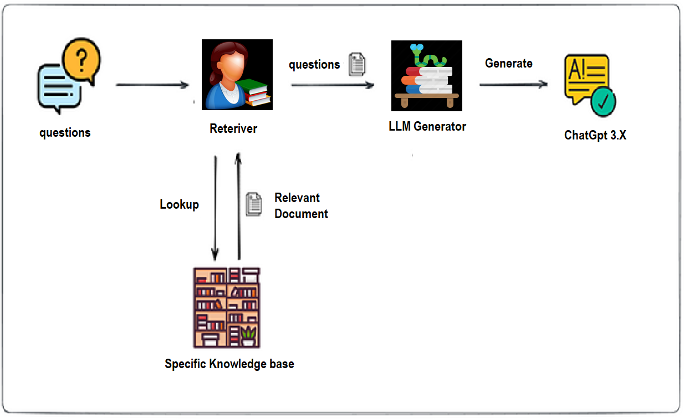

Future of MVP Developed
Using LLM/RAG
Benefits RAG-based setup
Retrieval-Augmented Generation (RAG) is quite straight-forward. Extract the information in our knowledge base. Instead of scratching (i.e. fine-tuning) comprehensively index the information of our knowledge base. Semantic Search (smart retrieval) has been around for quite some time and so has generative AI (some primitive forms have been around for decades).
1. Clear indication of the source Allowing to validate the source which the answer was based.
3. Maintainable Search Index. With Changes to KB, we can adapt our Search Index to reflect those changes.
2. No or Less hallucinate, by restricting generator component to our knowledge base, it will admit it can’t formulate a response when no relevant sources were found by the retriever.

Slide 5
Challenges 🤔
1. Overcome data privacy and security concerns, manage AI bias and ethical issues, and align AI strategies with HR and business goals.
1. Trade-off to be made in restriction to stick to info in knowledge base.
1. Strong dependency on the performance of the Smart Retriever.
Opportunities 🚀
1. Prompt engineering as a way to steer generation toward success.
1. Getting and keeping your LLM solution in production (LLMOps).
Seize new opportunities for innovation, differentiation, and competitive advantage through AI-powered HR Onboarding that delivers superior employee experiences and business outcomes.

